Slide 1
AI Enabled Social Distancing
Prepared By :-
Siddharth Mohanty 18BCE0103
Harshit Goel 18BCE0165
Abhishek Kumar 18BCE0424
Venkanna Dora Palaparthi 19BCE0006

Slide 2
Introduction
The generation of the novel coronavirus disease (COVID-19) was reported in late December 2019 in Wuhan, China. After a few months, the virus was hit by the global outbreak in 2020. In May 2020 The WHO announced the situation as a pandemic situation .
The statistics by WHO , somewhere around August 2020 confirms 2.38 crore infected people in around 200 countries. The mortality rate of the novel Coronavirus (COVID-19) also shows a scary number of approximately 1.5 crore people from all over the world.
With the growing trend of patients, the matter of relief is that we have recently developed the vaccine and vaccination started almost a month before. Scientists, healthcare organisations, and researchers with their continuous hard work have succeeded to produce the vaccine which also tackles the new strain of COVID-19.
Therefore, precautions are taken by the whole world along with the vaccine to limit the spread of infection. Due to these harsh conditions , most of the countries have imposed a lockdown to prevent the initial spread of Coronavirus. As a result, the economies of most of the countries have been affected drastically. Now these countries are struggling to bring their economies right back on track.

Slide 3
Abstract
Social distancing is a recommended solution by the World Health Organisation (WHO) to minimise the spread of COVID-19 in public places. The majority of governments and national health authorities have set the 2-meter physical distance as a mandatory safety measure in shopping centres, schools and other covered areas.
In this research, we develop a generic Deep Neural Network-Based model for automated people detection, tracking, and inter-people distances estimation in the crowd, using common CCTV security cameras.
The proposed model includes a YOLOv4-based framework and inverse perspective mapping for accurate people detection and social distancing monitoring in challenging conditions, including people occlusion, partial visibility, and lighting variations. We also provide an online risk assessment scheme by statistical analysis of the Spatio-temporal data from the moving trajectories and the rate of social distancing violations.
We identify high-risk zones with the highest possibility of virus spread and infections. This may help authorities to redesign the layout of a public place or to take precautionary actions to mitigate high-risk zones.

Slide 4
Literature Survey
TITLE | Key Concept | Advantage / Disadvantage
Monitoring COVID-19 social distancing with person detection and tracking via fine-tuned YOLO v3 and Deepsort techniques | This paper uses Yolo v3 object detection approach to separate out people from the background of the data and applies deepsort technique to follow the identified people. In order to detect multiple objects at the same time given a background, anchor boxes were used which are overlaid on the dataset input over different locations having different sizes and aspect ratios.Then the trained model gives output as bounding boxes set and an ID for each person identified through object detection. | The results discussed by the authors did not have any statistical analysis regarding the outputs generated. The paper did not discuss any privacy related issue regarding the surveillance footage and tracking of persons which are as much important as the need of these technologies
R-fcn: Object detection via region-based fully convolutional networks | This paper proposes a state-of-the-art system which is a region-based and fully convolutional object detection system. It is fully convolutional with approx. all the computations shared on the image. The authors have proposed score maps which are position sensitive in order to achieve an efficient object detection mechanism.

Slide 5
Literature Survey
Title- Monitoring COVID-19 social distancing with person detection and tracking via fine-tuned YOLO v3 and Deepsort techniques
Methodology- This paper uses Yolo v3 object detection approach to separate out people from the background of the data and applies deepsort technique to follow the identified people. In order to detect multiple objects at the same time given a background, anchor boxes were used which are overlaid on the dataset input over different locations having different sizes and aspect ratios.Then the trained model gives output as bounding boxes set and an ID for each person identified through object detection.
Disadvantage- The results discussed by the authors did not have any statistical analysis regarding the outputs generated. The paper did not discuss any privacy related issue regarding the surveillance footage and tracking of persons which are as much important as the need of these technologies

Slide 6
TITLE- Optical flow based moving object detection and tracking for traffic surveillance
METHODOLOGY- The proposed method in the paper is based on OFE(Optical Flow Estimation) combined with image processing techniques which includes median filtering and thresholding algorithms.The algorithm designed first selects a scene from the static camera and calculates mean of each frame on gray scale format, after which OFE is executed. Optical flow is used to describe the direction and the velocity and rate of pixels per unit time in a time sequence consisting of two consequent images. To filter out undesired noises and speckles, median filtering is used which may cause some holes in the images. To fill those holes for minimising detection mistakes, morphological closing is implemented by the authors.
DISADVANTAGE- Additional processes have to be included to compensate in situations where the camera is shaking throughout the video

Slide 7
TITLE- R-fcn: Object detection via region-based fully convolutional networks
METHODOLOGY- This paper proposes a state-of-the-art system which is a region-based and fully convolutional object detection system. It is fully convolutional with approx. all the computations shared on the image. The authors have proposed score maps which are position sensitive in order to achieve an efficient object detection mechanism.
DISADVANTAGE- Fully convolutional Instance Segmentation systems show errors on overlapping instances or objects and leads to creation of spurious edge

Slide 8
TITLE- Strong social distancing measures in the united states reduced the covid-19 growth rate: Study evaluates the impact of social distancing measures on the growth rate of confirmed covid-19 cases across the united states.
METHODOLOGY- This paper measures the impact of the guidelines implemented by the government in the USA and its effect in decreasing the cases of COVID-19. It is the study conducted between March 1, 2020, and April 27, 2020. This paper studies each of the policy’s impact on the growth of the COVID-19 cases.
DISADVANTAGE- Currently if you need 95% of the basic things , keras is the first choice.

Slide 9
TITLE- Object Detection through Modified YOLO Neural Network
METHODOLOGY- Improvement based on Loss Function :- Before YOLOv1 network brought the same error for both large and small objects , due to which using this model gives very unsatisfactory results.But now to remove this error in this paper, the author has made use of variance functions.
Improvement Of SPP Structure Model :- By using the SPP layer , image with much more features are obtained and also their is a great improvement in the network field.
DISADVANTAGE- In the future , the authors are expected to extend their work by building a hybrid detector for small and large size objects detection.

Slide 10
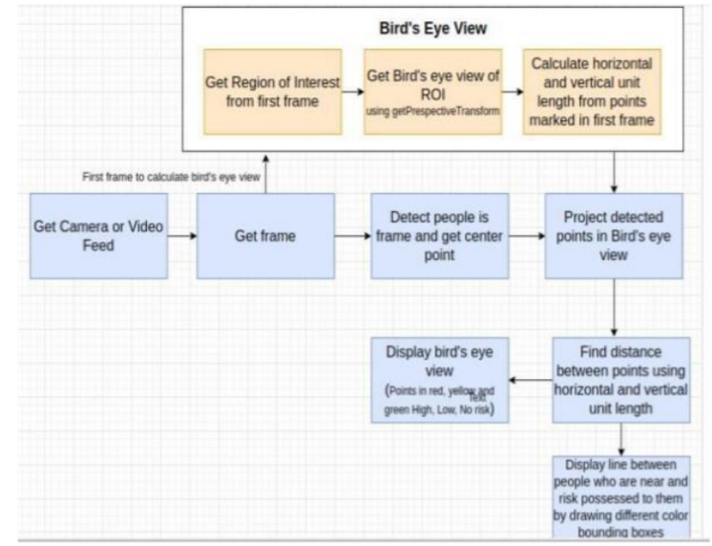
Proposed Methodology

Slide 11
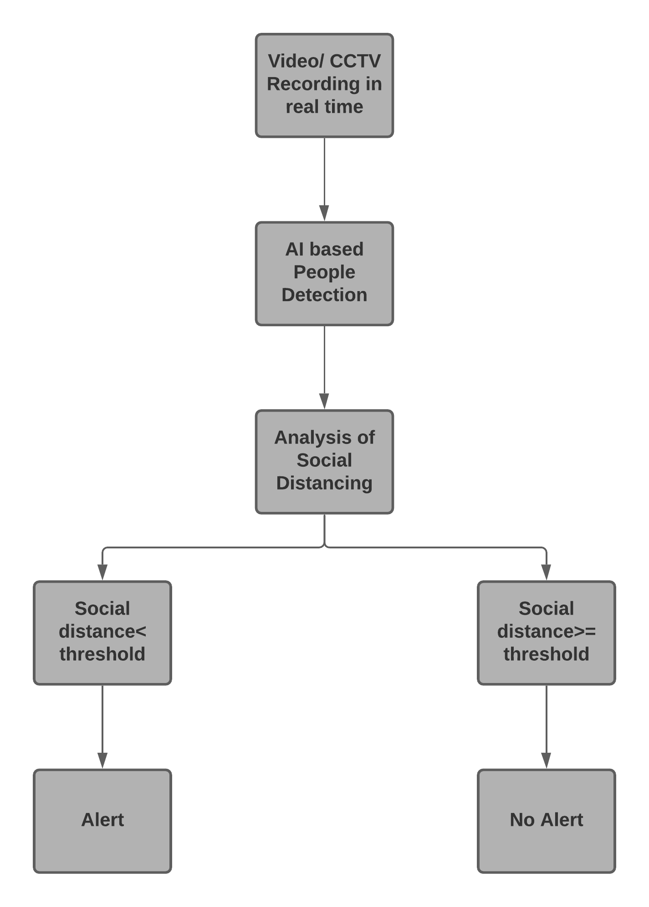

Slide 12
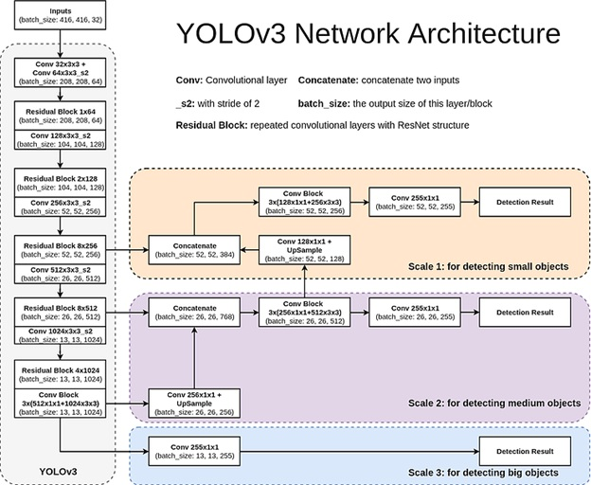

Slide 13
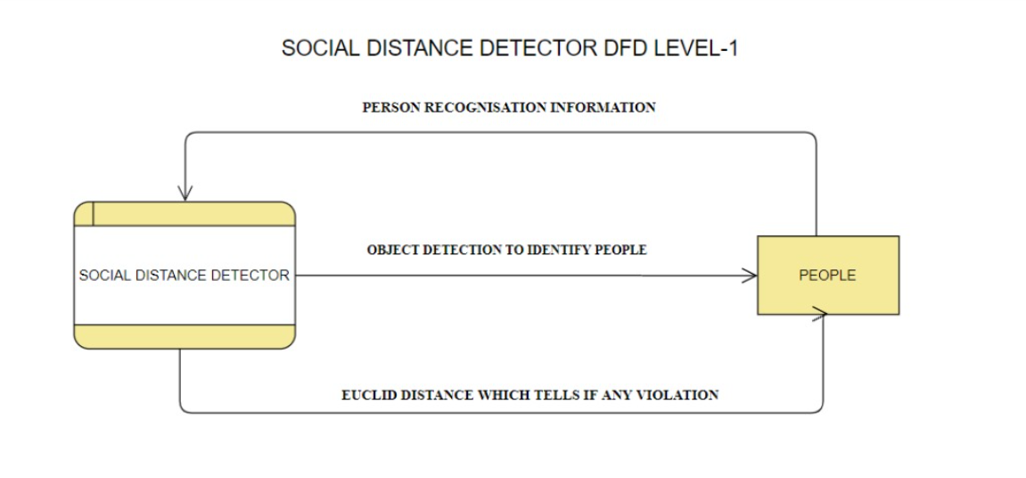

Slide 14
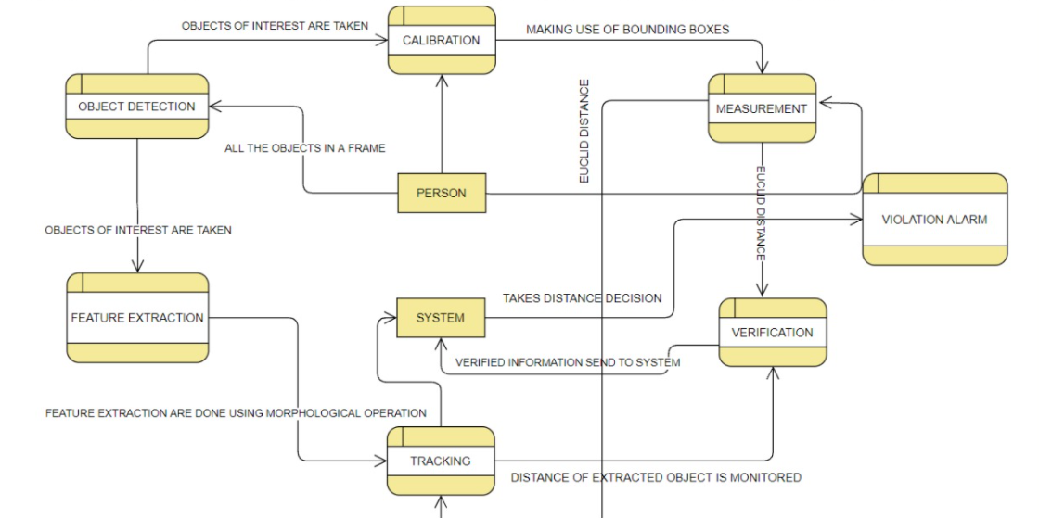

Slide 15
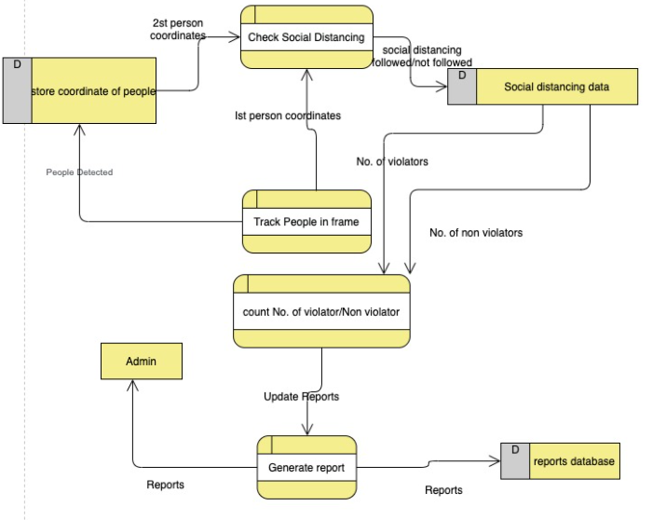

Slide 16
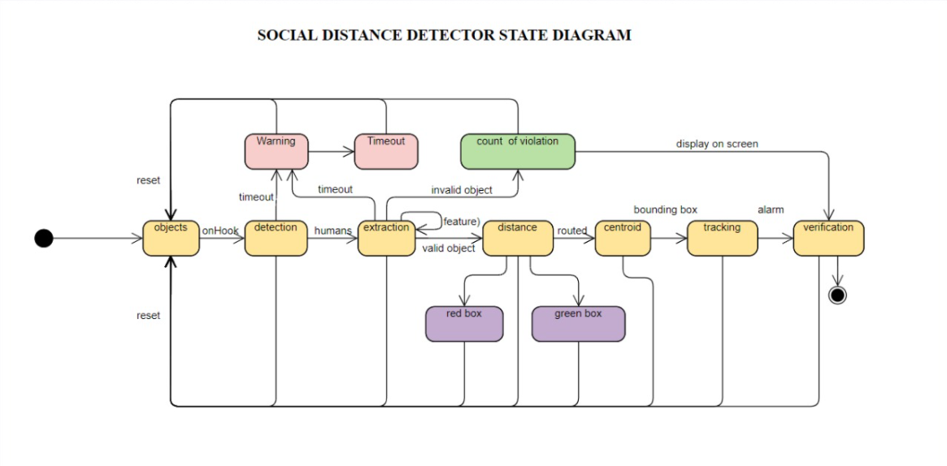

Slide 17
Architecture
Figure provides a diagrammatic representation of the network architecture of our system. The major concept of YOLO is to build a CNN network to predict a (7, 7, 30) tensor.
It uses a CNN network to reduce the spatial dimension to 7×7 with 1024 output channels at each location. YOLO performs a linear regression using two fully connected layers to make 7×7×2 boundary box predictions (the middle picture below).
To make a final prediction, we keep those with high box confidence scores (greater than 0.25) as our final predictions (the right picture). The class confidence score for each prediction box is computed as: class confidence score = box confidence score x conditional class probability.

Slide 18
Process Model and Justification
In this project, we are using the “Iterative Model”.
Iterative design is a methodology that repeatedly comes up in discussions about creating more accurate results on training data sets.
Iterative design is a methodology that positions our real simulation into a real world experience that we should regularly tweak and improve upon as we go, rather than building it in one fell swoop and being done for good.
We can think of the iterative design process as a continuous cycle of prototyping, testing, and making adjustments and refinements and becomes better as the number of test samples and training data set increases.
So rather than building an entire Social distancing Control algorithm from start to finish without any testing or user feedback – like we would do if we were using the traditional waterfall methodology – iterative design is an ongoing, incremental process.
One part of a simulation is designed, created, and tested, and is built upon a recent data set.

Slide 19
Risk Identification
Risk Type | Possible Risks
Technology | Insufficient Light
Technology | The inbuilt library support is removed from developer side
Tools | Hardware failure
Estimation | The rate of defect repair is underestimated
Estimation | The time required to develop the software is underestimated

Slide 20
Risk Analysis
Possible Risks | Probability | Effects
Insufficient Light | High | Serious
The inbuilt library support is removed from developer side | High | Serious
Hardware failure | Moderate | Catastrophic
The rate of defect repair is underestimated | Moderate | Tolerable
The time required to develop the software is underestimated | Moderate | Tolerable

Slide 21
Functional Requirements
As this is very challenging task for all our team members , to make it easy only a bit we have divided the project into 7 modules
Detection of Objects- From classification made by feature extraction step than we identify human being from input frame
Measurement of Distance- This is the third step of the pipeline, where the (x, y) location of the bounding box for each person has been estimated in the box view
Calibration- In this component the distance between every pair of objects is found out and if distance is less than threshold value then we increment the violation count by 1.
Feature Extraction-In this component the important features of human beings like face, hand, legs are found and classified into different parts.

Slide 22
Functional Requirements
Verification- One object detection is done we then verify that given object detected is human being by classifying object and finding important feature in object if feature is found than object is verified.
Tracking- In tracking step the location of each object is identified and stored in 3d vector space.
To implement all these different modules we have make use of DarkNet architecture , YOLO algorithm and OpenCV

Slide 23
Non Functional Requirements
Safety of the Camera that are installed on the street , because they are our point of contact and if any breakdown happens in our camera then everything is lost
We should provide safety to the alarm system as well because that will also be present on the streets , so equal and high chances of getting damaged
Making our system hack proof , So that only registered users can access the data and make changes if they want / necessary
Providing the encrypted way to transfer data from the camera to the system for monitoring the social distancing system and then generating the report
This project is safe , usable and observe its surrounding every 3 seconds at the run time
Project is testable, maintainable, extensible and scalable
The product should also have following properties adaptable, available, correctness, flexibility, interoperability, maintainability, portability, reliability, reusability, robustness, testability, and usability.

Slide 24
WBS
The WBS is breakdown in 6 modules for easy working and maintenance purpose
Calibration
Detection of Objects
Measurement of Distances
Feature Extraction
Tracking
Verification

Slide 25
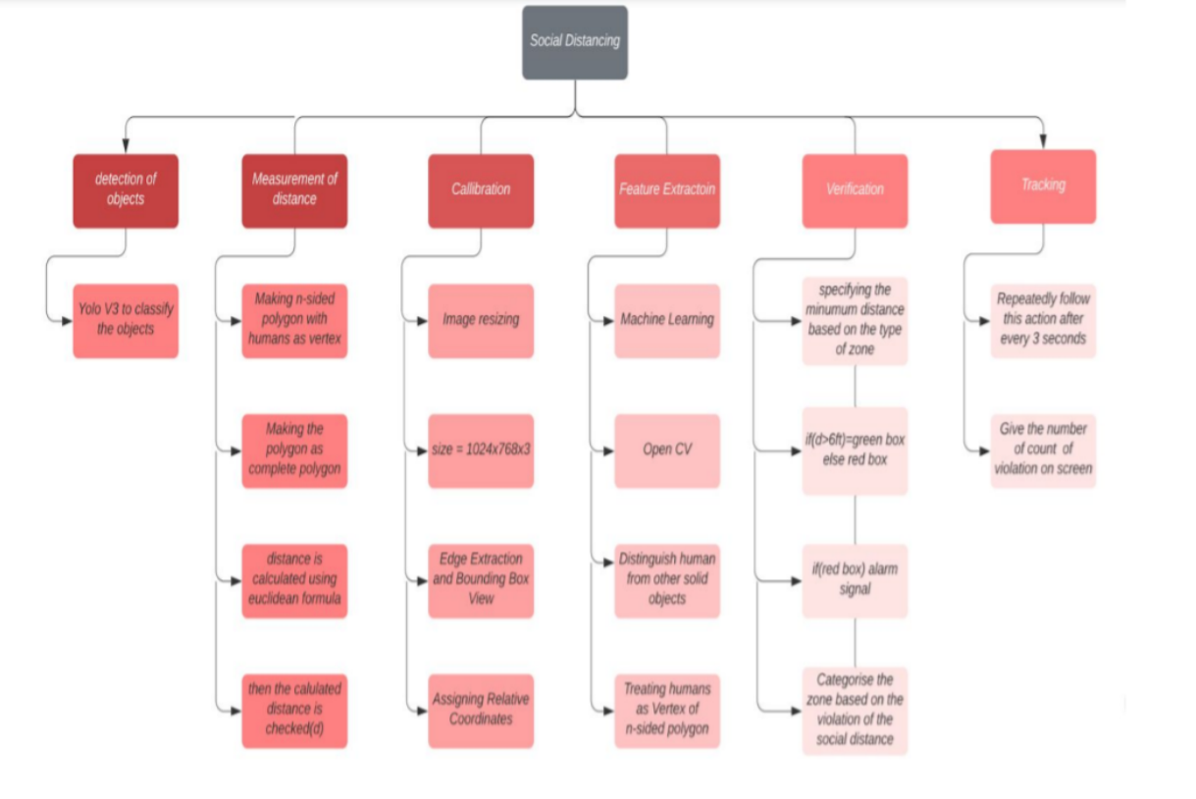

Slide 26
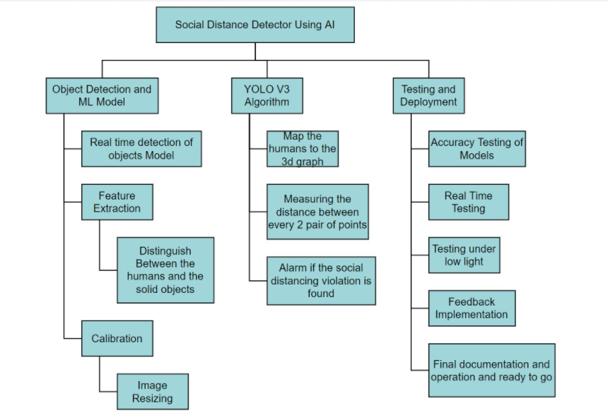

Slide 27
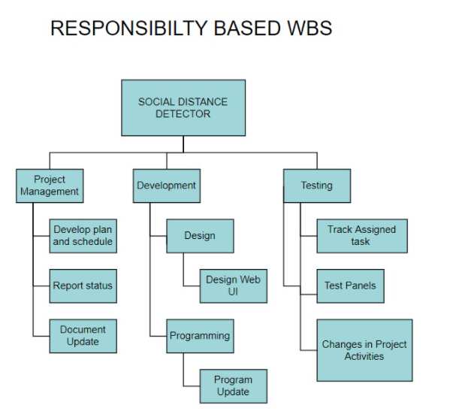

Slide 28
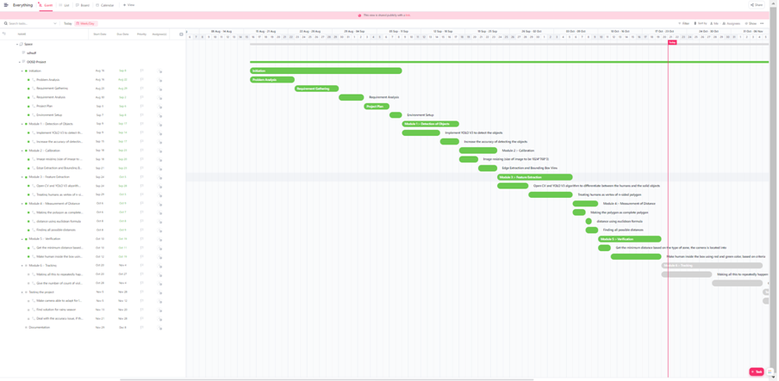

Slide 29
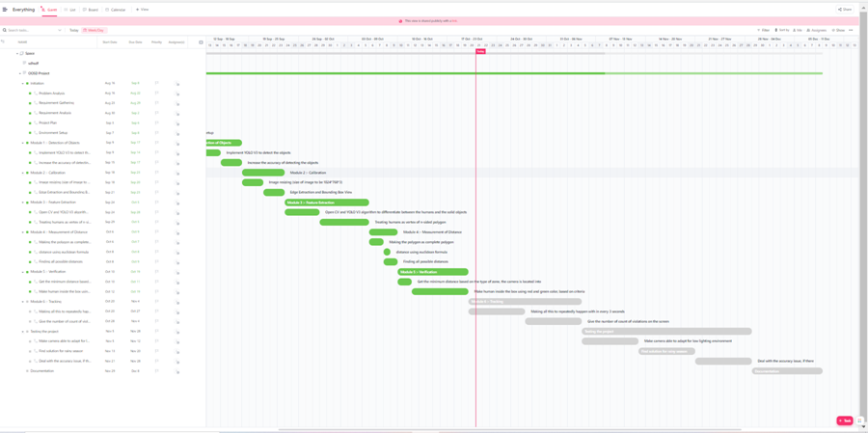

Slide 30
Challenges
Since this application is meant to be utilized in any working environment; accuracy and precision are highly desired to serve the aim . Higher number of false positives may raise discomfort and panic situations among people being observed. There can also be genuinely raised concerns about privacy and individual rights which may be addressed with some additional measures like prior consents for such working environments, hiding a person’s identity in general, and maintaining transparency about its fair uses within limited stakeholders.
Social distancing indicator needs manual calibration for image detection right now. In cases where more people are in a 3D space, it is difficult to indicate and mark the images. Potential solutions can be working on an overhead image (essentially a 2D image of human heads) which detects human heads and calculates distances between the detected windows easily by finding the vector distance between coordinates on image. We are not doing face detection and recognition right now. It would be good to include some face data and carry out recognition as well (can be used for real time attendance).

